Slide 1

Capstone Project IBM Applied Data Science Capstone
Opening an Italian Restaurant in Toronto
-Pranav N

Slide 2

Problem Statement
We plan to open an Italian Restaurant in the Neighborhoods of Toronto
Accordingly, we aim to decide on locations that will have the greatest possibility of success
Business Question:
If a restaurateur plans on opening an Italian restaurant in Toronto where must he/she be guided to open one?

Slide 3
Data Definitions
Data required
List of Neighborhoods in Toronto
Latitudes and Longitudes of various locations
Existing Restaurant locations along with venue data
Sources of data
Wikipedia page of Toronto neighborhoods
Geocoder package for latitude and longitude
Foursquare API for venue and location data.

Slide 4

Methodology
Web scraping Wikipedia page for neighborhood data
Pulling co-ordinate data from Geocoder
Using the Foursqaure API to get venue data based on coordinates
Grouping y neighborhood and analyzing the frequency of locations within each venue
Using k-means clustering to classify and group the data
Visualizing the clusters by super-imposing results on the map of Toronto

Slide 5
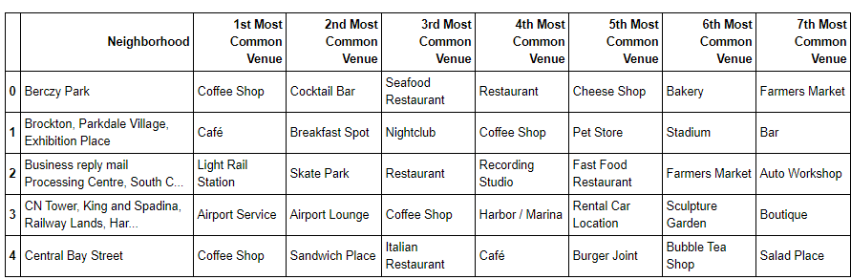
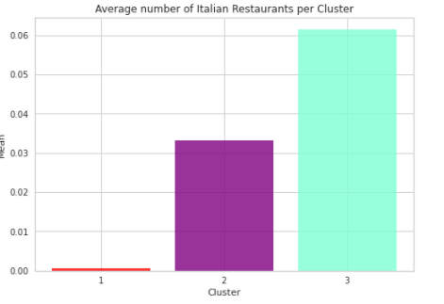
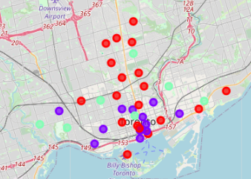
Results
We found the most common venues in each neighborhood to get a better sense of the data
After which we performed k-means clustering to find out the optimal number of 3 clusters for the data
Cluster 1: Had the least amount of Italian restaurants
Cluster 2: Had moderate number
Cluster 3: Had the highest incidence

Slide 6
Discussion & Recommendation
Discussion:
Based on the clusters and the map, we can see that the greatest number of restaurants are clustered around the south side of Toronto near the downtown area
We would advise to open an Italian restaurant in Cluster 1 given the low incidence of Italian
Recommendation:
Opening an Italian restaurant in Cluster 1.
This location would face the least amount of competition.
It would be advisable to focus on the Summerhill, Davis-ville and Rosedale regions given the younger population and higher incidence and inclination to fine-dining.

Slide 7



Thank you!

